Slide 1
Northwind

Slide 2
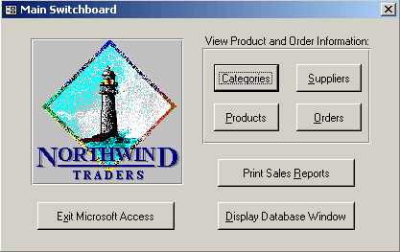
Northwind Traders
“Northwind Traders Access database is a sample database that shipped with Microsoft Office suite.”
“The Northwind database contains the sales data for a fictitious company called Northwind Traders, which imports and exports specialty foods from around the world.”

Slide 3
Northwind and Pubs DBs Today
scripts are free and available to download to create the entire DB on SQL servers
14 tables
0 triggers
16 views
7 stored procedures
0 user defined functions
1 user defined data types
used as a typical example DB in courses, online articles and so on

Slide 4
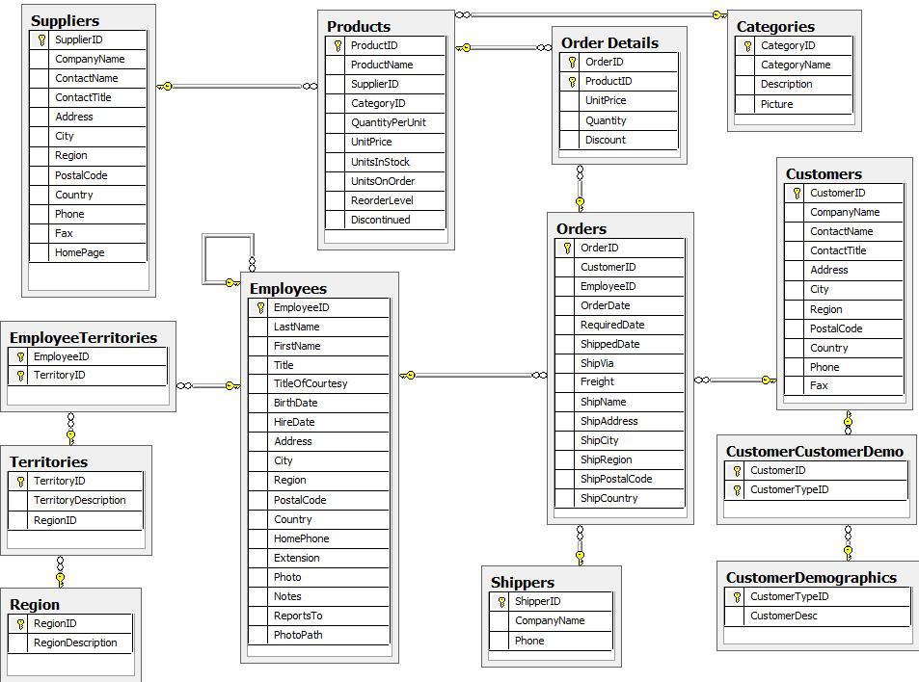
Northwind DB ER-Diagram

